Slide 1


CMR TECHNICAL CAMPUS UGC AUTONOMOUS DEPARTMENT OF CSE-DATASCIENCE MAJOR PROJECT REVIEW I ON
FAKE ACCOUNT DETECTION USING MACHINE LEARNING AND DATA SCIENCE
UNDER THE GUIDANCE OF
Mrs. V. PREMA TULASI
(ASSISTANT PROFESSOR)
PRESENTED BY:
E. PAVAN KUMAR(217R1A67E2)
CH. SANJAY KUMAR(217R1A67D7)
R. KARTHIK(227R5A6716)

Slide 2
List of content
Abstract
Understanding of the Problem
Literature Review and Summary
Design and Modelling
Preparation of the Problem
Implementation
Expected Output
References

Slide 3
Abstract
Nowadays, Online Social Media is dominating the world in several ways. Day by day the number of users using social media is increasing drastically. The main advantage of online social media is that we can connect to people easily and communicate with them in a better way. This provided a new way of a potential attack, such as fake identity, false information, etc. A recent survey suggest that the number of accounts present in the social media is much greater than the users using it. This suggest that fake accounts have been increased in the recent years. Online social media providers face difficulty in identifying these fake accounts. The need for identifying these fake accounts is that social media is flooded with false information, advertisements, etc..

Slide 4
Understanding of the Problem
The existing systems use very fewer factors to decide whether an account is fake or not. The factors largely affect the way decision making occurs
Existing systems often rely on only a few factors—like profile age, post frequency, or basic engagement metrics—which limits their effectiveness against the increasingly nuanced tactics used in fake account creation.
There is an exceptional improvement in fake account creation, which is unmatched by the software or application used to detect the fake account. Due to the advancement in creation of fake account, existing methods have turned obsolete
The most common algorithm used by fake account detection Applications is the Random forest algorithm. The algorithm has few downsides such as inefficiency to handle the categorical variables which has different number of levels

Slide 5
Drawbacks of existing system
Limited Feature Sets:
Many systems rely on a small set of features, like account age or posting frequency, limiting detection accuracy. These basic factors can be easily manipulated by fake accounts.
Difficulty Handling Large-Scale Data:
With millions of accounts, current systems may struggle with scalability, leading to slow detection speeds and increased computational costs, particularly for real-time detection.
Insufficient Adaptation to High-Cardinality Categorical Data:
Algorithms like Random Forest have limitations with high-cardinality categorical variables (e.g., diverse IP addresses or unique device IDs), requiring extensive preprocessing and slowing down detection

Slide 6
Literature Review
Logistic Regression (LR): Used in early detection systems with basic feature sets
Decision Trees (DT) & Random Forest (RF): Applied for their interpretability and robustness in detecting bot accounts
Support Vector Machines (SVM): Effective in high-dimensional spaces but computationally expensive
Neural Networks (NN): Capable of learning complex patterns but require large datasets
Autoencoders for anomaly detection: Effective in detecting fake accounts with low false positive rates

Slide 7
Literature Review and summary :
Recurrent Neural Networks (RNNs) and Long Short-Term Memory (LSTM) models analyze sequential data for detecting bot-like behavior
Graph Neural Networks (GNNs) leverage social network structures to improve detection accuracy
Summary :
Machine learning and data science have significantly contributed to improving fake account detection. While existing methods demonstrate promising results, continuous advancements are required to tackle emerging threats and enhance the robustness of detection systems

Slide 8
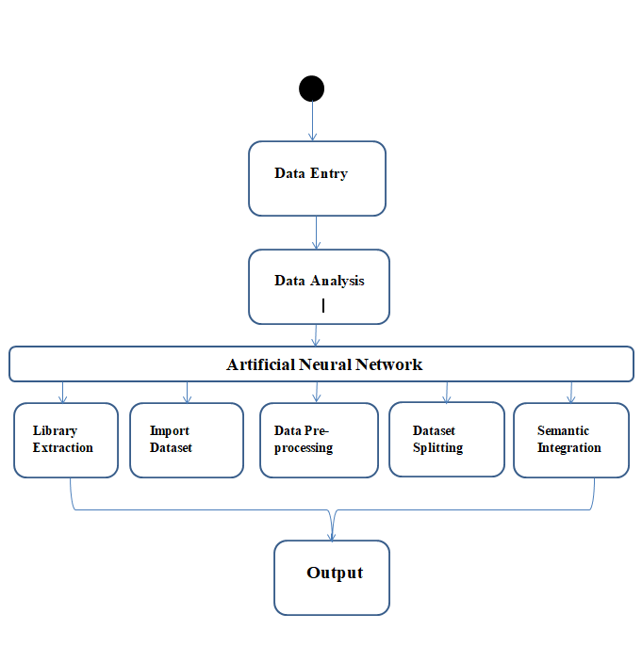
Design And Modelling

Slide 9
Preparation of the Problem
Dataset collection
Social media profiles and engagement metrics
Preprocessing techniques:
Handling missing values
Data normalization
Splitting dataset into training and testing sets
Model selection and training

Slide 10
Implementation
Upload social network profile dataset
Data preprocessing
Training model using ANN
Analyzing accuracy and loss
Predicting fake/genuine profiles

Slide 11
Expected Output
High accuracy in detecting fake accounts
Reduction in false positives and negatives
Improved security and trust in social media platforms
Faster processing and analysis of large datasets

Slide 12
References
“Detection of Fake Twitter accounts with Machine Learning Algorithms” Ilhan aydin,Mehmet sevi, Mehmet umut salur.
“Detection of fake profile in online social networks using Machine Learning” Naman singh, Tushar sharma, Abha Thakral, Tanupriya Choudhury.
“Detecting Fake accounts on Social Media” Sarah Khaled, Neamat el tazi, Hoda M.O. Mokhtar.
“Twitter fake account detection”, Buket Ersahin, Ozlem Aktas, Deniz kilinc, Ceyhun Akyol.

Slide 13
THANK YOU

